Slide 1
Intro to Machine Learning
Week 5 – Classification part 2

Slide 2
Today’s Class
Bayes Theorem
Naïve Bayes
K-Nearest Neighbors (KNN)
Support Vector Machines (SVM)

Slide 3
Classification – Review
Logistic Regression
Simple, parametric, linear technique for binary classification
Linear Discriminant Analysis (LDA)
Popular parametric method for multi-class classification that assumes Gaussian (normally) distributed predictors with same variance.
Uses Bayes Theorem to make probability predictions
Quadratic Discriminant Analysis (QDA)
Essentially the same as LDA but without assumption that predictors have the same variance.
More flexible version of LDA

Slide 4
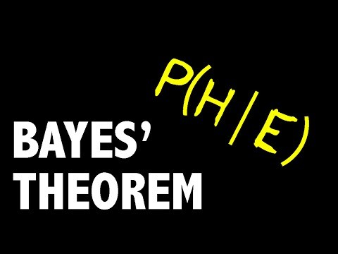
Bayes Theorem – Example

Slide 5

Bayes Theorem
$P\left(Y | X\right)=\frac{P(X|Y)P\left(X\right)) }{P(Y)}$

Slide 6
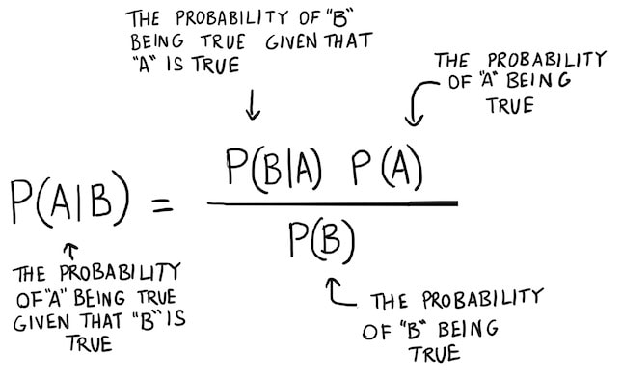
Bayes Theorem

Slide 7
Bayes Classification
Class of statistical classifiers based on Bayes Theorem
Aim to predict class membership probabilities
Notes:
Remember, LDA used Bayes theorem to make predictions

Slide 8
Naïve Bayes
Type of classifier based upon Bayes Theorem
Main assumption: independence (naivety) among predictors
Simple and easy to implement, fast training & prediction
Often outperforms other highly sophisticated classification methods
Has multiple subtypes with different assumptions:
1) Gaussian NB
2) Multinomial NB
3) Bernoulli NB

Slide 9
Naïve Bayes – Independence of Features
Simple example:
A fruit may be considered an apple if it is red, round, and about 3 inches in diameter.
Even if these features depend on each other or upon the existence of the other features…
Each feature independently contributes to the probability that the fruit is an apple.

Slide 10
Naïve Bayes – Subtypes
1) Gaussian NB
Makes assumption that predictors follow a Gaussian distribution
2) Multinomial NB
Assumes multinomial distribution of predictors.
Used most commonly with text classification.
3) Bernoulli NB
Assumes binary predictors.
Also commonly used in text classification
For example, binary predictors = different words. 1 = word does appear in document, 0 = word does not appear in the document

Slide 11
Naïve Bayes Example
We have a data set with ‘weather’ as the predictor and a corresponding target variable ‘play’ (lets say soccer).
We want to classify whether players will play or not based on the weather…
Steps:
1) Covert data set to frequency table
2) Create likelihood table by finding the probabilities
3) Use Naïve Bayesian equation to calculate the posterior probability for each class with the highest posterior probability is the outcome of prediction.
Posterior probability = conditional probability that is assigned after the relevant evidence or background is taken into account

Slide 12
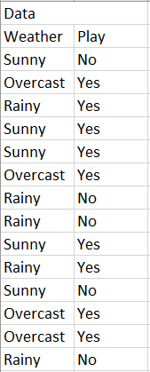
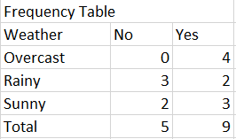
Naïve Bayes – Example

Slide 13
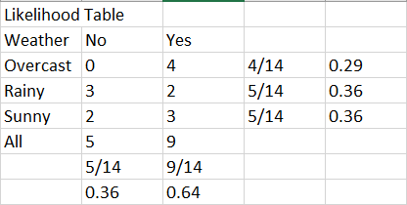
Naïve Bayes - Example

Slide 14
Naïve Bayes – Example
Lets find out if our NB model will predict the players will be play on a sunny day…
P(yes|sunny) = P(sunny|yes)*P(Yes) / P(sunny)
P(sunny|yes) = 3/9 = 0.33
P(sunny) = 5/14 = 0.36
P(yes) = 9/14 = 0.64
So… P(yes|sunny) = 0.33*0.64 / 0.36 = 0.60
Prediction = Yes
Notes:
What if we add a new variable “temperature” to our data set…
This highlights a drawback of Naïve Bayes:
Naïve Bayes will not be able to take into account the connection between certain weather conditions and certain temperatures
If it is sunny and -15 degrees out you will likely not see them playing soccer, but Naïve Bayes will not be able to see this connection

Slide 15
Naïve Bayes - Advantages and Drawbacks
Advantages:
Easy and fast implementation, prediction due to limited computation
Performs well for multi-class prediction
When independence assumption holds, outperforms logistic regression
Also needs less data to train
Drawbacks:
Not known to output the most accurate probabilities, more focused on the classifying correctly
Assumption of completely independent predictors is rarely met in the real world
Will run into issues if a categorical variable exists in the test set that does not in the training set

Slide 16
Naïve Bayes – Real World Applications
1) Real-time prediction
Its speed allows for near-real-time predictions to work
2) Text classification / Spam Filtering / Sentiment Analysis
3) Recommendation System
Often used as part of ML systems that can predict if a user would like a given resource or not (online retailers)

Slide 17
Naïve Bayes – Final words
Very easy implementation with very low computing power necessary
Performs best with cleaned, normally distributed data with few correlated features
Try it for any classification problem!
Test against other algorithms, it often outperforms them
Should be one of the first methods you try in classification

Slide 18
K-Nearest-Neighbors
Non-parametric classification method
Does not make assumptions on the distribution of our features.
Can also be used for regression.
Easy to interpret
Insensitive to outliers/random noise
Mainly used with quantitative variables
Can technically be used with qualitative variables with special distance functions
Notes:
Less commonly used for regression

Slide 19
KNN – Prediction step by step
1) Choose value for k
2) Calculate similarity based on distance function
Many distance functions but most commonly used in Euclidean
3) Determine K nearest neighbors based upon distance
4) Make majority decision based on neighbors
Notes:
Say we have an observation in a data set we are trying to classify…

Slide 20
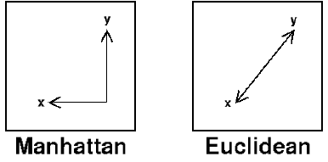
KNN – Distance Functions

Slide 21
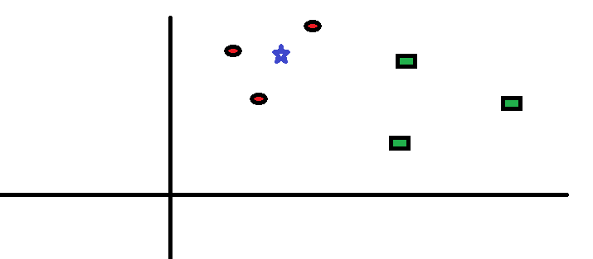
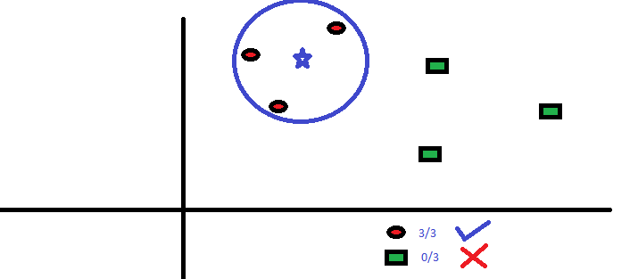
KNN – Simple Example
What should we classify the blue star as based on the information we have?

Slide 22
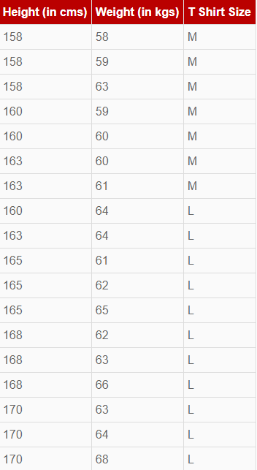
Knn – Full example
We run T-shirt company and have some data about customer’s height, weight, and T shirt size.
We have a new customer named ‘Stu’ who has a height of 161cm and a weight of 61kg.
We want to predict his T-shirt size…

Slide 23
Knn – Full Example
Step #1:
Choose value for k
Step #2:
Use Euclidean distance function to calculate similarity
Step #3:
Find the nearest neighbors
Step #4:
Make a prediction

Slide 24
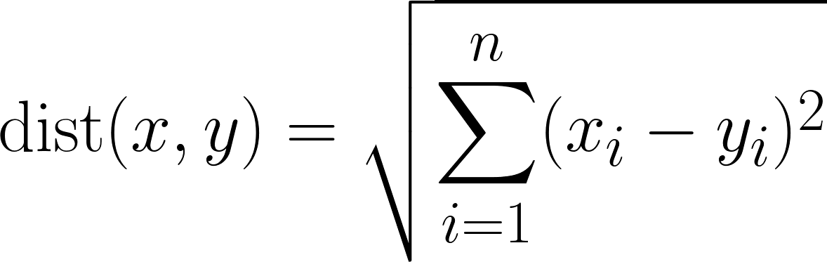
KNn – Full Example
1) Choose value of k
Let k = 5
2) Calculate Euclidean distance
Euclidean distance =
Example: distance between the first observation and a new observation (Stu) =
=SQRT((161-158)^2+(61-58)^2)
We repeat this for all observations compared to our new observation

Slide 25
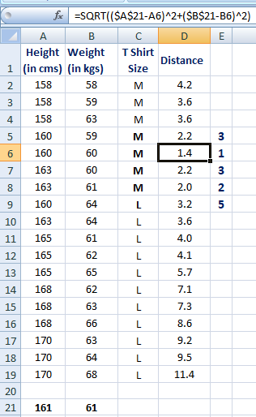
Knn – Full Example
3) Find k-nearest-neighbors:

Slide 26
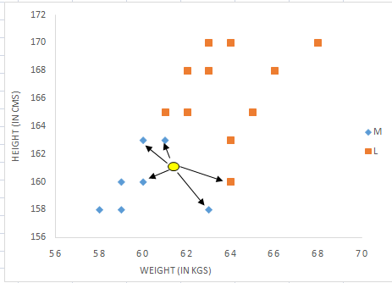
KNn – Full example
4) Make prediction:
Prediction:
Stu wears a Medium size shirt

Slide 27
KNN – Advantages and Drawbacks
Advantages:
Simple implementation
Flexible non-parametric approach can be used with complex predictor-target relationships
Naturally handles multi-class cases effectively
Performs well in practice with enough training data
Disadvantages:
Prone to overfitting, especially if k is small
Computationally expensive, as algorithm stores all of the training data
High memory requirement
Prediction can be slower with large amount of data

Slide 28
KNn – Final Notes
Very simple, should be one of the first methods you try in multi-class classification problems
You will need a relatively significant amount of data to get accurate
Do not use when p > n

Slide 29
Support Vector Machines (SVM)
Powerful and flexible non-parametric class of algorithms used for both regression and classification
More complex than the previous models we have covered
Very high accuracy, even with a smaller (clean) data sets
Efficient as it only uses a subset of training data point

Slide 30
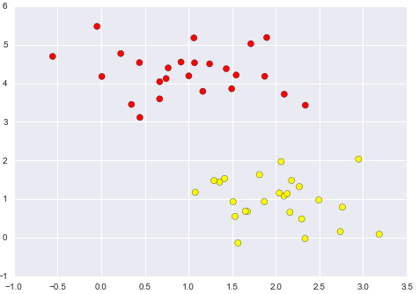
SVM – simple example
Notes:
What is the best way to distinguish between these two classes?
A linear discriminative classifier might try to draw a straight line that separates these two sets of data.

Slide 31
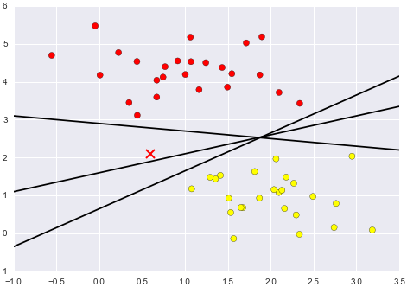
SVM – simple example
Notes:
We want to identify the class that the red X belongs to.
What we have here are three very different separators which all perfectly discriminate between the samples.
These could all be thought of as their own model
Depending on which model we choose, the red X will be assigned to a different class.
Thus, our assumption of drawing a line between the classes is not enough
Which model do we use and why?

Slide 32
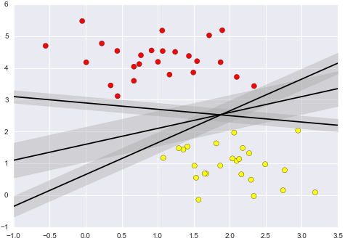
SVM – simple example
Main goal of SVM = Maximize the margin

Slide 33
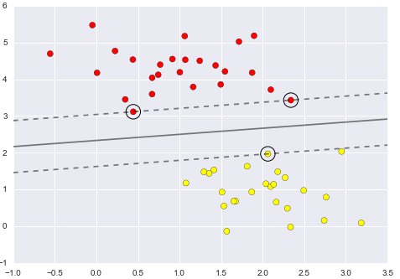
SVM – Fitting a Linear SVM model
Here we plotted a dividing line that maximizes the margin between the two classes
Notice some of the points touch the margin…
These are out support vectors
According to SVM, these are the only points that matter
Any point further from the margin which are on the correct side do not modify the fit!
Notes:
The data points that are not at the margin do not contribute to the loss function used to fit the model
Thus, their position and number do not matter so long as they do not cross the margin.

Slide 34
SVM - Kernels
What about data that is not linearly separable?
SVM becomes extremely powerful when combined with kernels.
Kernels allow us to project our data into higher-dimensional space defined by polynomials and Gaussian basis functions
Thus we are able to fit for nonlinear relationships with a linear classifier.

Slide 35
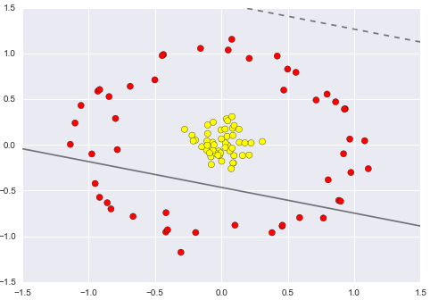
SVM - Kernels
There is no way we can use linear discrimination to separate these classes…
So we use a basis function to project the data into a higher dimension such that a separator would work!

Slide 36
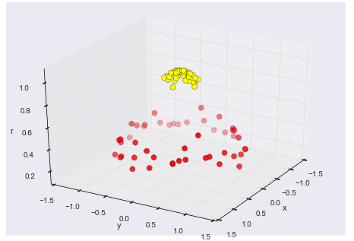
SVM - Kernels

Slide 37
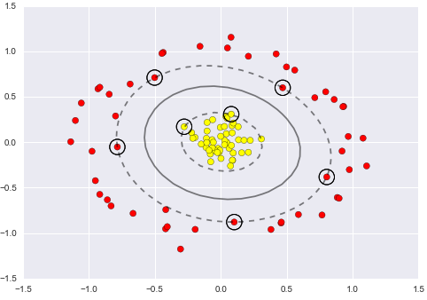
SVM - Kernels

Slide 38
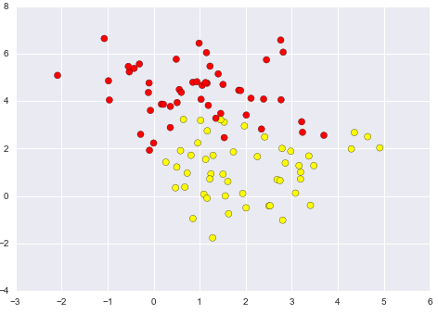
SVM – Tuning the model
What if a perfect boundary does not exist?
How do we handle overlap?
Answer:
We soften the margins

Slide 39
SVM – Parameters
C
Penalty parameter of the error term.
Controls the trade off between a smooth boundary and classifying the training points correctly
Responsible for softening the margins
The smaller the value for C the smaller the margins
Gamma
Kernel coefficient for ‘rbf’, ’poly’, and ‘sigmoid’ kernel functions
Higher the value, the more complex the model gets
Also, the more prone to overfitting

Slide 40
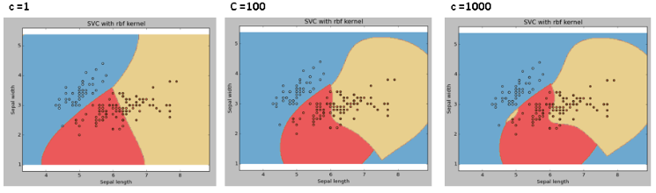
SVM - Parameters
Notes:
C

Slide 41
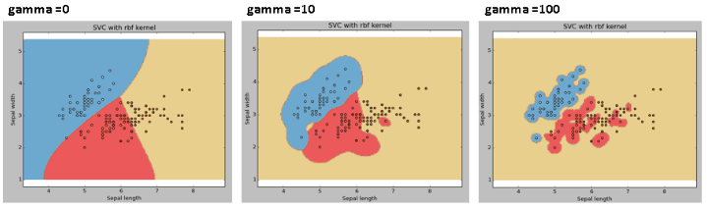
SVM - Parameters
Notes:
Rbf kernel with varying gamma values
Tuning parameter gamma:
The higher the value of gamma the more complex the model gets

Slide 42
SVM – Advantages and Drawbacks
Advantages:
Reliance on relatively few support vectors means they are compact models, take up very little memory
Once model is trained, prediction is very fast
Works very well with high-dimensional data
Even with data where p > n
Integration with kernel methods makes them very flexible, able to adapt to many data types
Drawbacks:
Training can be computationally expensive with a large number of training samples
Strongly dependent on suitable choice for softening parameter
Results do not have direct probabilistic interpretation
Can be estimated (although the computational cost is high)
Also may struggle when there is significant noise or overlap between classes

Slide 43
SVM – Final Notes
Use SVM when other simpler, faster, less-tuning intensive methods have been shown ineffective.
Quite a bit of tuning is likely necessary to get the model to perform the way you want.
If you have the CPU capable of training and cross-validating SVM on your data, the method can lead to excellent results.

